Slide 1

Parul University
Session: July-Dec. 2024
Slide No. 1

Slide 2
Parul University
203105374: Design & Analysis of Algorithm
Date
Slide No.

Slide 3
Unit-3 Greedy Algorithm
Greedy Methods: Introduction and Problem statements
Selection Sort
Greedy methods with examples such as Optimal Reliability Allocation
Knapsack problem
Minimum Spanning trees – Prim’s and Kruskal’s algorithms,
Single source shortest paths - Dijkstra’s and Bellman Ford algorithms.
Slide No.

Slide 4
Greedy Methods
The greedy method is one of the strategies like Divide and conquer used to solve the problems.
This method is used for solving optimization problems. An optimization problem is a problem that demands either maximum or minimum results. Let's understand through some terms.
The Greedy method is the simplest and straightforward approach. It is not an algorithm, but it is a technique.
The main function of this approach is that the decision is taken on the basis of the currently available information.
Whatever the current information is present, the decision is made without worrying about the effect of the current decision in future.
Slide No.

Slide 5
Cont…
This technique is basically used to determine the feasible solution that may or may not be optimal.
The feasible solution is a subset that satisfies the given criteria. The optimal solution is the solution which is the best and the most favorable solution in the subset.
In the case of feasible, if more than one solution satisfies the given criteria then those solutions will be considered as the feasible, whereas the optimal solution is the best solution among all the solutions.
Feasible solution:- Most problems have n inputs and its solution contains a subset of inputs that satisfies a given constraint(condition). Any subset that satisfies the constraint is called feasible solution.
Optimal solution: To find a feasible solution that either maximizes or minimizes a given objective function. A feasible solution that does this is called optimal solution.
Slide No.

Slide 6
Components of Greedy Algorithm
The components that can be used in the greedy algorithm are:
Candidate set: A solution that is created from the set is known as a candidate set.
Selection function: This function is used to choose the candidate or subset which can be added in the solution.
Feasibility function: A function that is used to determine whether the candidate or subset can be used to contribute to the solution or not.
Objective function: A function is used to assign the value to the solution or the partial solution.
Solution function: This function is used to intimate whether the complete function has been reached or not.
Slide No.
Notes:
Computer Science: Algorithms form the basis of computer programming and are used to solve problems ranging from simple sorting and searching to complex tasks such as artificial intelligence and machine learning.
Mathematics: Algorithms are used to solve mathematical problems, such as finding the optimal solution to a system of linear equations or finding the shortest path in a graph.
Operations Research: Algorithms are used to optimize and make decisions in fields such as transportation, logistics, and resource allocation.
Artificial Intelligence: Algorithms are the foundation of artificial intelligence and machine learning, and are used to develop intelligent systems that can perform tasks such as image recognition, natural language processing, and decision-making.
Data Science: Algorithms are used to analyze, process, and extract insights from large amounts of data in fields such as marketing, finance, and healthcare.

Slide 7
Algorithm for Greedy method
Algorithm Greedy(a,n)
//a[1:n] contains the n inputs.
{
Solution :=0;
For i=1 to n do
{
X:=select(a);
If Feasible(solution, x) then
Solution :=Union(solution,x);
}
Return solution; }
Slide No.

Slide 8
Selection:- Function, that selects an input from a[] and removes it. The selected input’s value is assigned to x.
Feasible:- Boolean-valued function that determines whether x can be included into the solution vector.
Union:- function that combines x with solution and updates the objective function.
Slide No.

Slide 9
Applications of Greedy Algorithm
It is used in finding the shortest path.
It is used to find the minimum spanning tree using the prim's algorithm or the Kruskal's algorithm.
It is used in a job sequencing with a deadline.
This algorithm is also used to solve the fractional knapsack problem.
Disadvantages of using Greedy algorithm
Greedy algorithm makes decisions based on the information available at each phase without considering the broader problem. So, there might be a possibility that the greedy solution does not give the best solution for every problem.
Slide No.

Slide 10
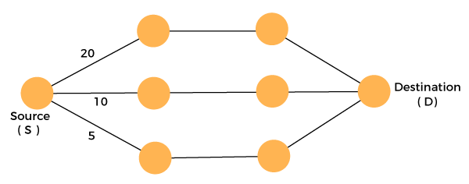
Cont..
It follows the local optimum choice at each stage with a intend of finding the global optimum. Let's understand through an example.
Consider the graph which is given below:
We have to travel from the source to the destination at the minimum cost. Since we have three feasible solutions having cost paths as 10, 20, and 5. 5 is the minimum cost path so it is the optimal solution. This is the local optimum, and in this way, we find the local optimum at each stage in order to calculate the global optimal solution.
Slide No.

Slide 11
Example.
Let's understand through an Suppose there is a problem 'P'. I want to travel from A to B shown as below:
P : A → B
The problem is that we have to travel this journey from A to B. There are various solutions to go from A to B. We can go from A to B by walk, car, bike, train, aeroplane, etc. There is a constraint in the journey that we have to travel this journey within 12 hrs. If I go by train or aeroplane then only, I can cover this distance within 12 hrs. There are many solutions to this problem but there are only two solutions that satisfy the constraint.
Slide No.

Slide 12
If we say that we have to cover the journey at the minimum cost. This means that we have to travel this distance as minimum as possible, so this problem is known as a minimization problem. Till now, we have two feasible solutions, i.e., one by train and another one by air. Since travelling by train will lead to the minimum cost so it is an optimal solution. An optimal solution is also the feasible solution, but providing the best result so that solution is the optimal solution with the minimum cost. There would be only one optimal solution.
The problem that requires either minimum or maximum result then that problem is known as an optimization problem. Greedy method is one of the strategies used for solving the optimization problems.
Slide No.

Slide 13
Greedy Algorithm Examples
Most networking algorithms use the greedy approach. Here is a list of few of them −
Travelling Salesman Problem
Prim's Minimal Spanning Tree Algorithm
Kruskal's Minimal Spanning Tree Algorithm
Dijkstra's Minimal Spanning Tree Algorithm
Graph - Map Coloring
Knapsack Problem
Job Scheduling Problem
Slide No.

Slide 14
Selection Sort
In selection sort, the smallest value among the unsorted elements of the array is selected in every pass and inserted to its appropriate position into the array. It is also the simplest algorithm. It is an in-place comparison sorting algorithm. In this algorithm, the array is divided into two parts, first is sorted part, and another one is the unsorted part. Initially, the sorted part of the array is empty, and unsorted part is the given array. Sorted part is placed at the left, while the unsorted part is placed at the right.
Slide No.

Slide 15
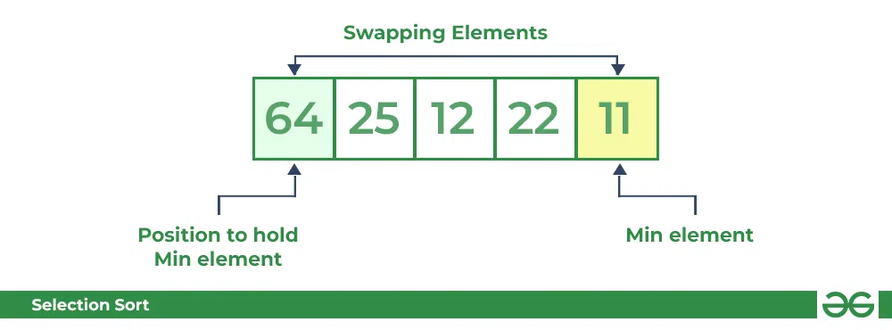
Lets consider the following array as an example: arr[] = {64, 25, 12, 22, 11}
First pass:
For the first position in the sorted array, the whole array is traversed from index 0 to 4 sequentially. The first position where 64 is stored presently, after traversing whole array it is clear that 11 is the lowest value.
Thus, replace 64 with 11. After one iteration 11, which happens to be the least value in the array, tends to appear in the first position of the sorted list.
Slide No.

Slide 16
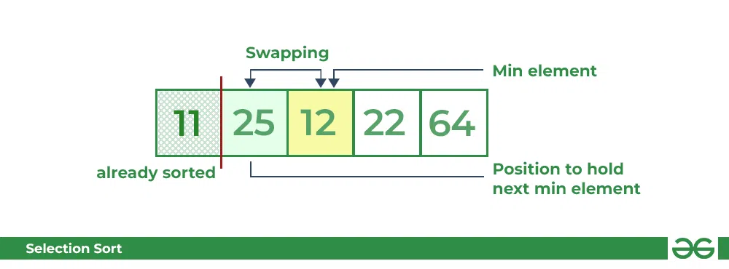
Second Pass:
For the second position, where 25 is present, again traverse the rest of the array in a sequential manner.
After traversing, we found that 12 is the second lowest value in the array and it should appear at the second place in the array, thus swap these values.
Slide No.

Slide 17
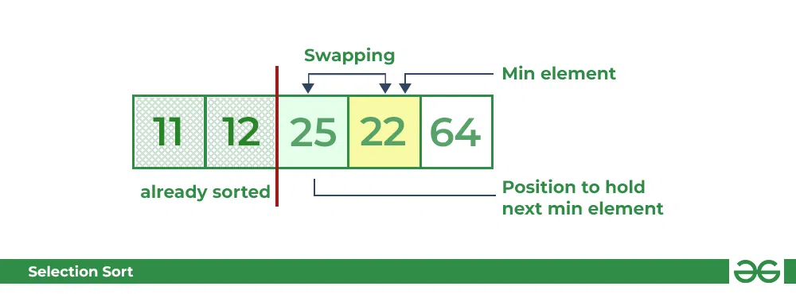
Third Pass:
Now, for third place, where 25 is present again traverse the rest of the array and find the third least value present in the array.
While traversing, 22 came out to be the third least value and it should appear at the third place in the array, thus swap 22 with element present at third position.
Slide No.

Slide 18
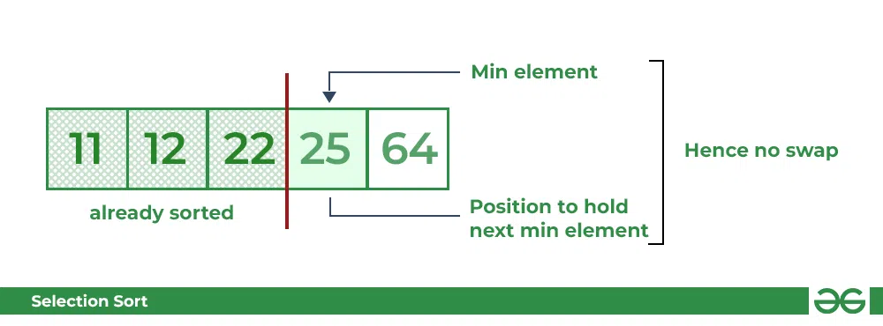
Fourth pass:
Similarly, for fourth position traverse the rest of the array and find the fourth least element in the array
As 25 is the 4th lowest value hence, it will place at the fourth position.
Slide No.

Slide 19
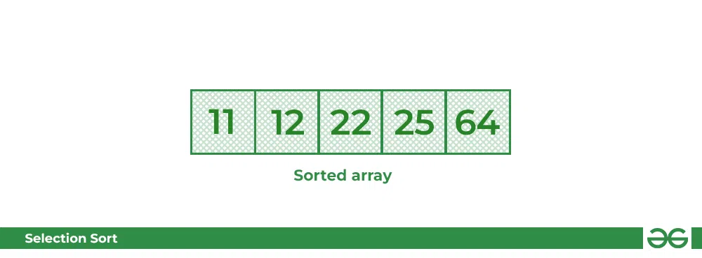
Fifth Pass:
At last the largest value present in the array automatically get placed at the last position in the array
The resulted array is the sorted array.
Slide No.

Slide 20
Algorithm
Step 1 − Set MIN to location 0
Step 2 − Search the minimum element in the list
Step 3 − Swap with value at location MIN
Step 4 − Increment MIN to point to next element
Step 5 − Repeat until list is sorted
Slide No.

Slide 21
Procedure Selection Sort
list : array of items
n : size of list
for i = 1 to n - 1
/* set current element as minimum*/
min = i
/* check the element to be minimum */
for j = i+1 to n
if list[j] < list[min] then
min = j;
end if
end for
/* swap the minimum element with the current element*/
if indexMin != i then
Slide No.

Slide 22
Complexity Analysis of Selection Sort
Time Complexity: The time complexity of Selection Sort is O(N²) as there are two nested loops:
One loop to select an element of Array one by one = O(N)
Another loop to compare that element with every other Array element = O(N)
Therefore overall complexity = O(N) * O(N) = O(N*N) = O(N²)
Slide No.

Slide 23
Knapsack Problem
Suppose you have been given a knapsack or bag with a limited weight capacity, and each item has some weight and value. The problem here is that “Which item is to be placed in the knapsack such that the weight limit does not exceed and the total value of the items is as large as possible?”.
Consider the real-life example. Suppose there is a thief and he enters the museum. The thief contains a knapsack, or we can say a bag that has limited weight capacity. The museum contains various items of different values. The thief decides what items are should he keep in the bag so that profit would become maximum.
Slide No.

Slide 24
Some important points related to the knapsack problem are:
It is a combinatorial optimization-related problem.
Given a set of N items – usually numbered from 1 to N; each of these items has a mass wi and a value vi.
It determines the number of each item to be included in a collection so that the total weight M is less than or equal to a given limit and the total value is as large as possible.
Slide No.

Slide 25
Some important points related to the knapsack problem are:
It is a combinatorial optimization-related problem.
Given a set of N items – usually numbered from 1 to N; each of these items has a mass wi and a value vi.
It determines the number of each item to be included in a collection so that the total weight M is less than or equal to a given limit and the total value is as large as possible.
Knapsack Problem Variants:
1. 0/1 knapsack problem
2. Fractional knapsack problem
Slide No.

Slide 26
1. 0/1 knapsack problem
A knapsack means a bag. It is used for solving knapsack problems. This problem is solved by using a dynamic programming approach. In this problem, the items are either completely filled or no items are filled in a knapsack. 1 means items are completely filled or 0 means no item in the bag.
For example, we have two items having weights of 12kg and 13kg, respectively. If we pick the 12kg item then we cannot pick the 10kg item from the 12kg item (because the item is not divisible); we have to pick the 12kg item completely.
In this problem, we cannot take the fraction of the items. Here, we have to decide whether we have to take the item, i.e., x = 1 or not, i.e., x = 0.
The greedy approach does not provide the optimal result in this problem.
Slide No.

Slide 27
2. Fractional knapsack problem
This problem is also used for solving real-world problems. It is solved by using the Greedy approach. In this problem we can also divide the items means we can take a fractional part of the items that is why it is called the fractional knapsack problem.
For example, if we have an item of 13 kg then we can pick the item of 12 kg and leave the item of 1 kg. To solve the fractional problem, we first compute the value per weight of each item.
Slide No.

Slide 28
Fractional Knapsack Problem
Given the weights and profits of N items, in the form of {profit, weight} put these items in a knapsack of capacity W to get the maximum total profit in the knapsack. In Fractional Knapsack, we can break items for maximizing the total value of the knapsack.
Greedy approach: In Greedy approach, we calculate the ratio of profit/weight, and accordingly, we will select the item. The item with the highest ratio would be selected first.
There are basically three approaches to solve the problem:
The first approach is to select the item based on the maximum profit.
The second approach is to select the item based on the minimum weight.
The third approach is to calculate the ratio of profit/weight.
Slide No.

Slide 29
Pseudocode of Fractional knapsack problem:
GREEDY_FRACTIONAL_KNAPSACK(X, V, W, M)
S ← Φ
// Set of selected items, initially empty
SW ← 0 // weight of selected items
SP ← 0 // profit of selected items
i ← 1
while i ≤ n do
if (SW + w[i]) ≤ M then
S ← S ∪ X[i]
SW ← SW + W[i]
SP ← SP + V[i]
else
frac ← (M – SW) / W[i]
S ← S ∪ X[i] * frac
// Add fraction of item X[i]
SP ← SP + V[i] * frac
// Add fraction of profit
SW ← SW + W[i] * frac
// Add fraction of weight
end
i ← i + 1
end
Slide No.

Slide 30
Example
Objects: 1 2 3 4 5 6 7
Profit (P): 5 10 15 7 8 9 4
Weight(w): 1 3 5 4 1 3 2
W (Weight of the knapsack): 15
n (no of items): 7
Slide No.

Slide 31
First approach:
The total profit would be equal to (15 + 10 + 9 + 8 + 5.25) = 47.25
Object | Profit | Weight | Remaining weight
3 | 15 | 5 | 15 - 5 = 10
2 | 10 | 3 | 10 - 3 = 7
6 | 9 | 3 | 7 - 3 = 4
5 | 8 | 1 | 4 - 1 = 3
7 | 7 * ¾ = 5.25 | 3 | 3 - 3 = 0
Slide No.

Slide 32
Second approach:
The second approach is to select the item based on the minimum weight.
Object | Profit | Weight | Remaining weight
1 | 5 | 1 | 15 - 1 = 14
5 | 7 | 1 | 14 - 1 = 13
7 | 4 | 2 | 13 - 2 = 11
2 | 10 | 3 | 11 - 3 = 8
6 | 9 | 3 | 8 - 3 = 5
4 | 7 | 4 | 5 - 4 = 1
3 | 15 * 1/5 = 3 | 1 | 1 - 1 = 0
In this case, the total profit would be equal to (5 + 7 + 4 + 10 + 9 + 7 + 3) = 46
Slide No.

Slide 33
Third approach:
In the third approach, we will calculate the ratio of profit/weight.
Objects: 1 2 3 4 5 6 7
Profit (P): 5 10 15 7 8 9 4
Weight(w): 1 3 5 4 1 3 2
In this case, we first calculate the profit/weight ratio.
Object 1: 5/1 = 5
Object 2: 10/3 = 3. 33
Object 3: 15/5 = 3
Object 4: 7/4 = 1.7
Object 5: 8/1 = 8
Object 6: 9/3 = 3
Object 7: 4/2 = 2
P:w: 5 3.3 3 1.7 8 3 2
In this approach, we will select the objects based on the maximum profit/weight ratio. Since the P/W of object 5 is maximum so we select object 5.
Slide No.

Slide 34
Third approach:
P:w: 5 3.3 3 1.7 8 3 2
Object | Profit | Weight | Remaining weight
5 | 8 | 1 | 15 - 1 = 14
1 | 5 | 1 | 14 - 1 = 13
2 | 10 | 3 | 13 - 3 = 10
3 | 15 | 5 | 10 - 5 = 5
6 | 9 | 3 | 5 - 3 = 2
7 | 4 | 2 | 2 - 2 = 0
Slide No.

Slide 35
Conclusion
As we can observe in the above table that the remaining weight is zero which means that the knapsack is full. We cannot add more objects in the knapsack.
Therefore, the total profit would be equal to (8 + 5 + 10 + 15 + 9 + 4), i.e., 51.
In the first approach, the maximum profit is 47.25. The maximum profit in the second approach is 46. The maximum profit in the third approach is 51.
Therefore, we can say that the third approach, i.e., maximum profit/weight ratio is the best approach among all the approaches.
Slide No.

Slide 36
Complexity Analysis
The fractional knapsack problem can be solved by first sorting the items according to their values, and it can be done in O(NlogN)
This approach starts with finding the most valuable item, and we consider the most valuable item as much as possible, so start with the highest value item denoted by v_{i}. Then, we consider the next item from the sorted list, and in this way, we perform the linear search in O(N) time complexity.
Therefore, the overall running time would be O(NlogN) plus O(N) equals to O(NlogN). We can say that the fractional knapsack problem can be solved much faster than the 0/1 knapsack problem.
Time Complexity: O(N * logN) Auxiliary Space: O(N)
Slide No.

Slide 37
Minimum Spanning Tree
A minimum spanning tree (MST) is defined as a spanning tree that has the minimum weight among all the possible spanning trees
A spanning tree is defined as a tree-like subgraph of a connected, undirected graph that includes all the vertices of the graph. It is a subset of the edges of the graph that forms a tree (acyclic) where every node of the graph is a part of the tree.
The minimum spanning tree has all the properties of a spanning tree with an added constraint of having the minimum possible weights among all possible spanning trees. Like a spanning tree, there can also be many possible MSTs for a graph.
Slide No.

Slide 38
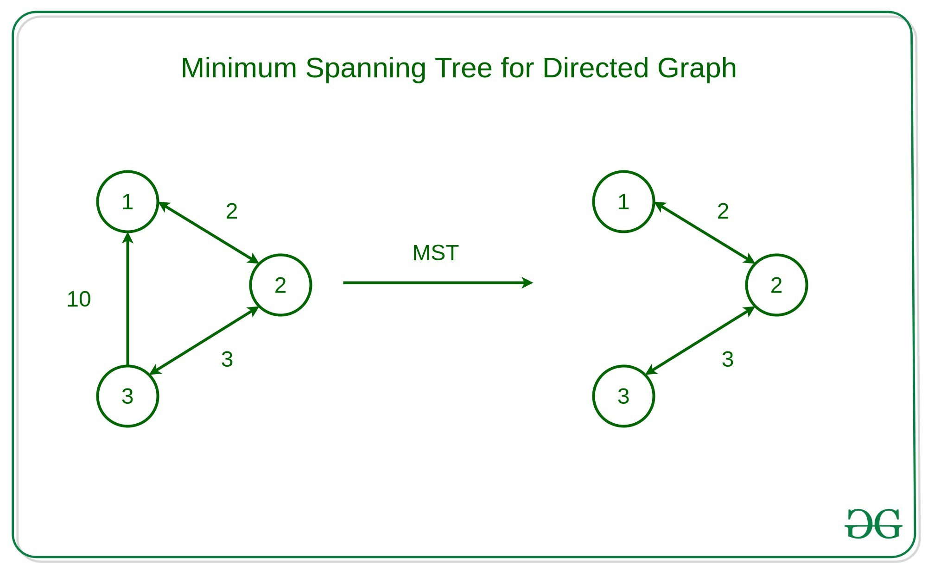
Slide No.

Slide 39
Properties of a Spanning Tree:
The number of vertices (V) in the graph and the spanning tree is the same.
There is a fixed number of edges in the spanning tree which is equal to one less than the total number of vertices ( E = V-1 ).
The spanning tree should not be disconnected, as in there should only be a single source of component, not more than that.
The spanning tree should be acyclic, which means there would not be any cycle in the tree.
The total cost (or weight) of the spanning tree is defined as the sum of the edge weights of all the edges of the spanning tree.
There can be many possible spanning trees for a graph.
Slide No.

Slide 40
Algorithms to find Minimum Spanning Tree:
Kruskal’s Minimum Spanning Tree Algorithm:
Prim’s Minimum Spanning Tree Algorithm:
Slide No.

Slide 41
Kruskal’s Minimum Spanning Tree Algorithm:
The algorithm workflow is as below:
First, it sorts all the edges of the graph by their weights,
Then starts the iterations of finding the spanning tree.
At each iteration, the algorithm adds the next lowest-weight edge one by one, such that the edges picked until now does not form a cycle.
This algorithm can be implemented efficiently using a DSU ( Disjoint-Set ) data structure to keep track of the connected components of the graph.
This is used in a variety of practical applications such as network design, clustering, and data analysis.
Slide No.

Slide 42
Algorithm
MST- KRUSKAL (G, w)
1. A ← ∅
2. for each vertex v ∈ V [G]
3. do MAKE - SET (v)
4. sort the edges of E into non decreasing order by weight w
5. for each edge (u, v) ∈ E, taken in non decreasing order by weight
6. do if FIND-SET (μ) ≠ if FIND-SET (v)
7. then A ← A ∪ {(u, v)}
8. UNION (u, v)
9. return A
Slide No.

Slide 43
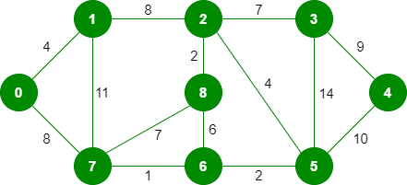
Example 1
The graph contains 9 vertices and 14 edges. So, the minimum spanning tree formed will be having (9 – 1) = 8 edges. After sorting:
Slide No.

Slide 44
Now pick all edges one by one from the sorted list of edges
Step 1: Pick edge 7-6. No cycle is formed, include it.
Weight Source Destination
1 7 6
2 8 2
2 6 5
4 0 1
4 2 5
6 8 6
7 2 3
7 7 8
8 0 7
8 1 2
9 3 4
10 5 4
11 1 7
14 3 5
Slide No.

Slide 45
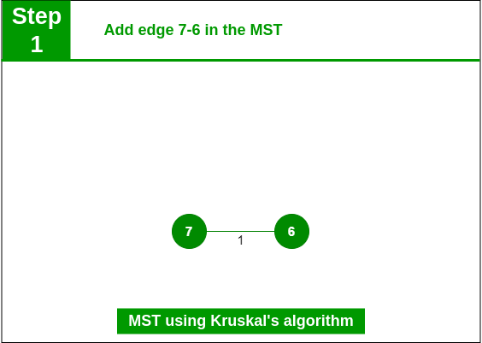
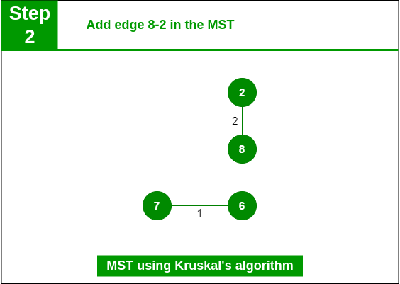
Step 2: Pick edge 8-2. No cycle is formed, include it.
Slide No.

Slide 46
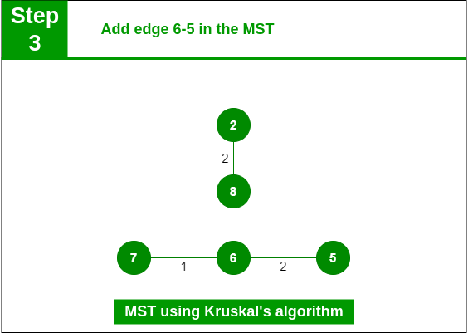
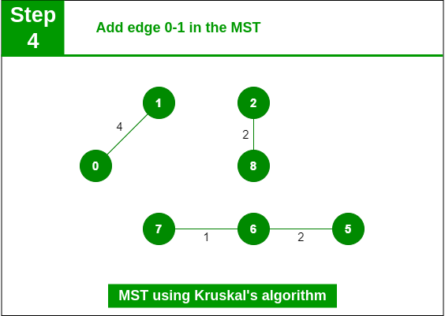
Step 3: Pick edge 6-5. No cycle is formed, include it.
Step 4: Pick edge 0-1. No cycle is formed, include it.
Slide No.

Slide 47
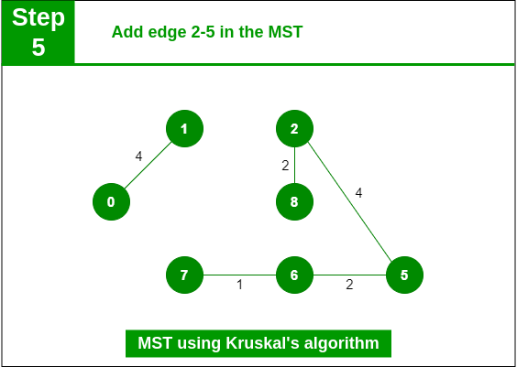
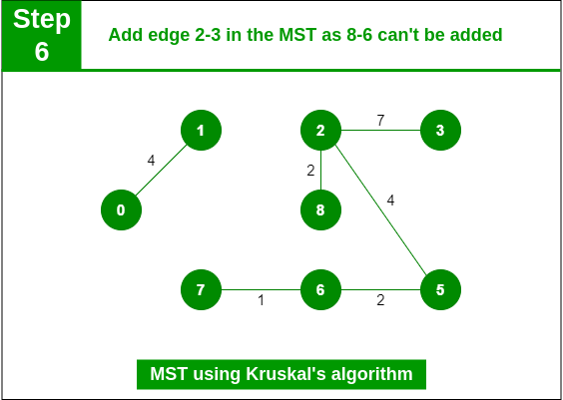
Step 5: Pick edge 2-5. No cycle is formed, include it.
Step 6: Pick edge 8-6. Since including this edge results in the cycle, discard it. Pick edge 2-3: No cycle is formed, include it.
Slide No.

Slide 48
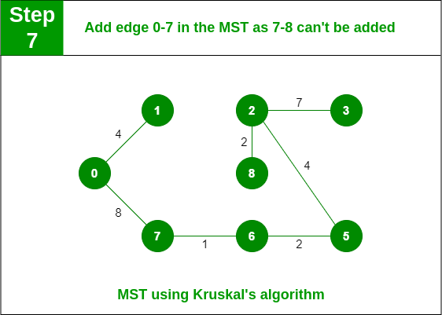
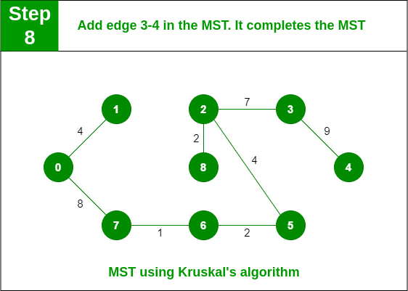
Step 7: Pick edge 7-8. Since including this edge results in the cycle, discard it. Pick edge 0-7. No cycle is formed, include it.
Step 8: Pick edge 1-2. Since including this edge results in the cycle, discard it. Pick edge 3-4. No cycle is formed, include it.
Slide No.

Slide 49
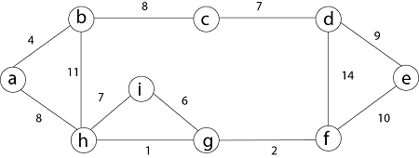
Example 2
Slide No.

Slide 50
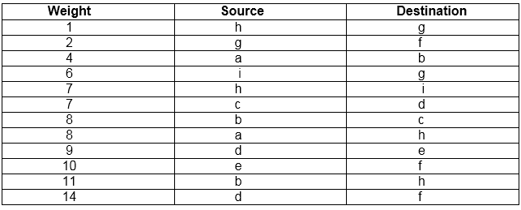
Slide No.

Slide 51
Complexity Analysis
Analysis: Where E is the number of edges in the graph and V is the number of vertices, Kruskal's Algorithm can be shown to run in O (E log E) time, or simply, O (E log V) time, all with simple data structures. These running times are equivalent because:
E is at most V² and log V²= 2 x log V is O (log V).
If we ignore isolated vertices, which will each their components of the minimum spanning tree, V ≤ 2 E, so log V is O (log E).
Thus the total time is
O (E log E) = O (E log V).
Slide No.

Slide 52
O(E * logE) or O(E * logV)
Sorting of edges takes O(E * logE) time.
After sorting, we iterate through all edges and apply the find-union algorithm. The find and union operations can take at most O(logV) time.
So overall complexity is O(E * logE + E * logV) time.
The value of E can be at most O(V²), so O(logV) and O(logE) are the same. Therefore, the overall time complexity is O(E * logE) or O(E*logV)
Auxiliary Space: O(V + E), where V is the number of vertices and E is the number of edges in the graph.
Slide No.

Slide 53
Prim’s algorithm:
Like Kruskal’s algorithm, Prim’s algorithm is also a Greedy algorithm. This algorithm always starts with a single node and moves through several adjacent nodes, in order to explore all of the connected edges along the way.
The algorithm starts with an empty spanning tree.
The idea is to maintain two sets of vertices. The first set contains the vertices already included in the MST, and the other set contains the vertices not yet included.
At every step, it considers all the edges that connect the two sets and picks the minimum weight edge from these edges. After picking the edge, it moves the other.
A group of edges that connects two sets of vertices in a graph is called cut in graph theory.
Slide No.

Slide 54
So, at every step of Prim’s algorithm, find a cut, pick the minimum weight edge from the cut, and include this vertex in MST Set (the set that contains already included vertices).
Slide No.

Slide 55
How does Prim’s Algorithm Work?
The working of Prim’s algorithm can be described by using the following steps:
Step 1: Determine an arbitrary vertex as the starting vertex of the MST.
Step 2: Follow steps 3 to 5 till there are vertices that are not included in the MST (known as fringe vertex).
Step 3: Find edges connecting any tree vertex with the fringe vertices.
Step 4: Find the minimum among these edges.
Step 5: Add the chosen edge to the MST if it does not form any cycle.
Step 6: Return the MST and exit
Slide No.

Slide 56
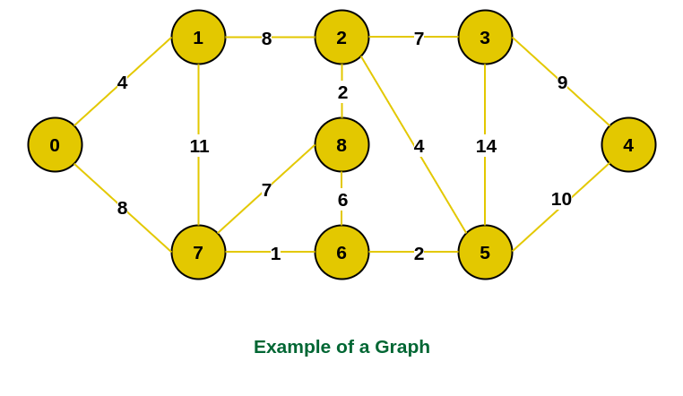
Illustration of Prim’s Algorithm:
Consider the following graph as an example for which we need to find the Minimum Spanning Tree (MST).
Slide No.

Slide 57
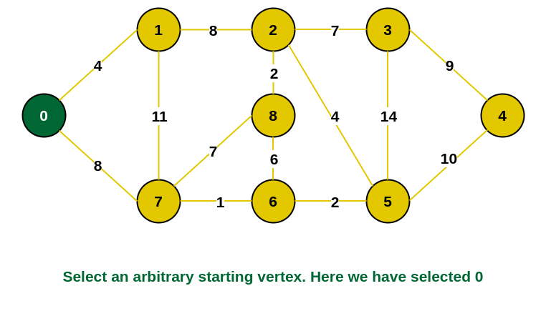
Step 1: Firstly, we select an arbitrary vertex that acts as the starting vertex of the Minimum Spanning Tree. Here we have selected vertex 0 as the starting vertex.
Slide No.

Slide 58
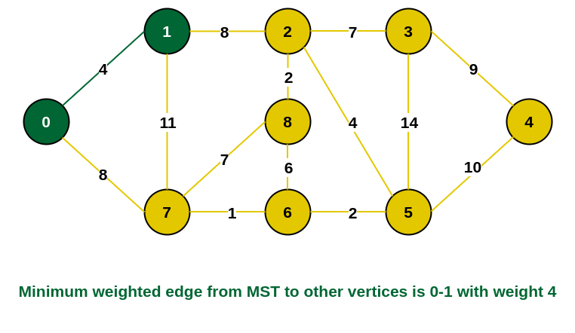
Step 2: All the edges connecting the incomplete MST and other vertices are the edges {0, 1} and {0, 7}. Between these two the edge with minimum weight is {0, 1}. So include the edge and vertex 1 in the MST.
Slide No.

Slide 59
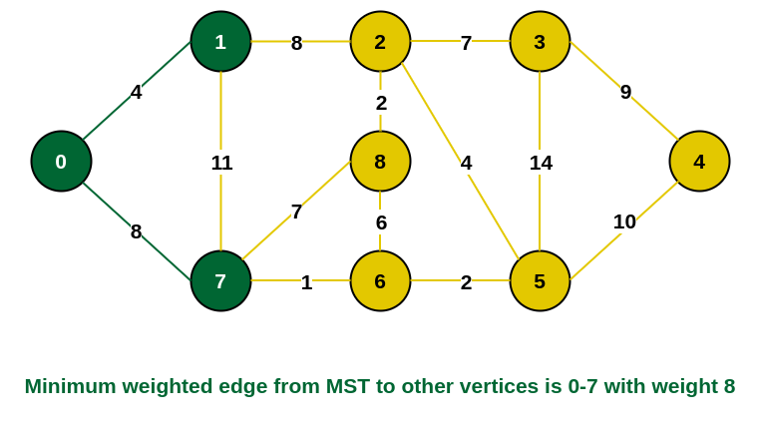
Step 3: The edges connecting the incomplete MST to other vertices are {0, 7}, {1, 7} and {1, 2}. Among these edges the minimum weight is 8 which is of the edges {0, 7} and {1, 2}. Let us here include the edge {0, 7} and the vertex 7 in the MST. [We could have also included edge {1, 2} and vertex 2 in the MST].
Slide No.

Slide 60
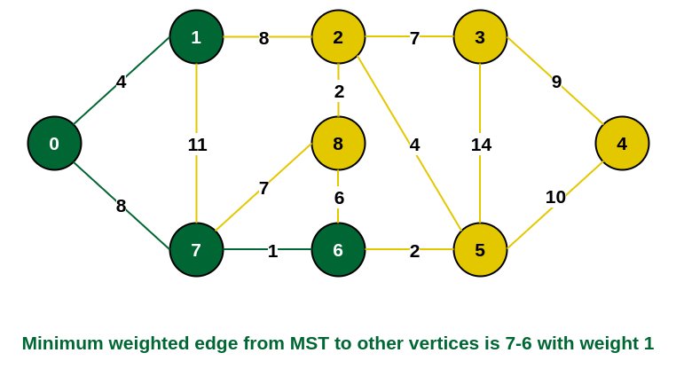
Step 4: The edges that connect the incomplete MST with the fringe vertices are {1, 2}, {7, 6} and {7, 8}. Add the edge {7, 6} and the vertex 6 in the MST as it has the least weight (i.e., 1).
Slide No.

Slide 61
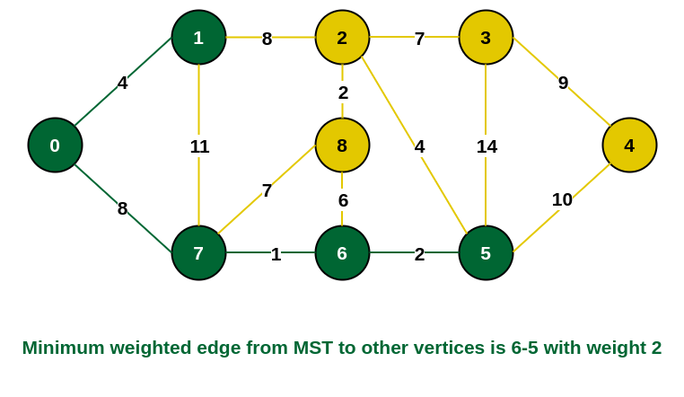
Step 5: The connecting edges now are {7, 8}, {1, 2}, {6, 8} and {6, 5}. Include edge {6, 5} and vertex 5 in the MST as the edge has the minimum weight (i.e., 2) among them.
Slide No.

Slide 62
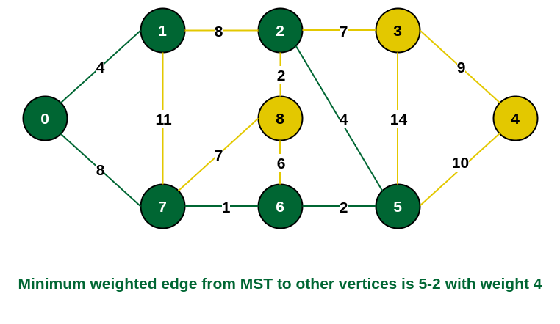
Step 6: Among the current connecting edges, the edge {5, 2} has the minimum weight. So include that edge and the vertex 2 in the MST.
Slide No.

Slide 63
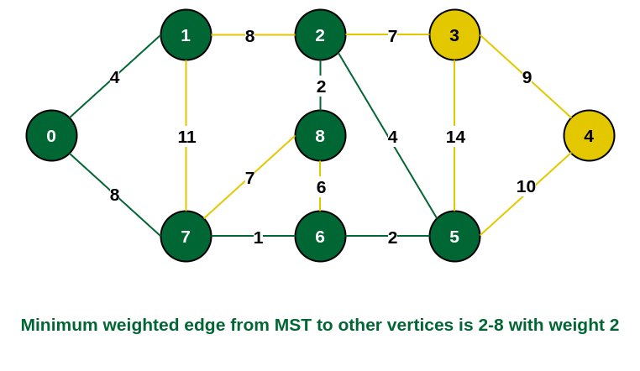
Step 7: The connecting edges between the incomplete MST and the other edges are {2, 8}, {2, 3}, {5, 3} and {5, 4}. The edge with minimum weight is edge {2, 8} which has weight 2. So include this edge and the vertex 8 in the MST.
Slide No.

Slide 64
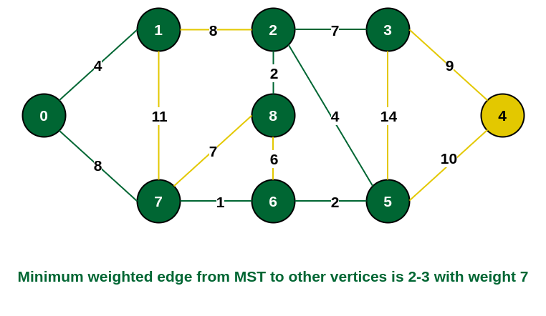
Step 8: See here that the edges {7, 8} and {2, 3} both have same weight which are minimum. But 7 is already part of MST. So we will consider the edge {2, 3} and include that edge and vertex 3 in the MST.
Slide No.

Slide 65
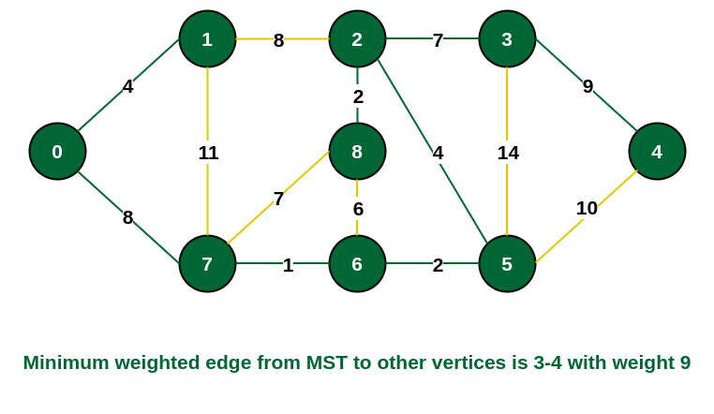
Step 9: Only the vertex 4 remains to be included. The minimum weighted edge from the incomplete MST to 4 is {3, 4}.
Slide No.

Slide 66
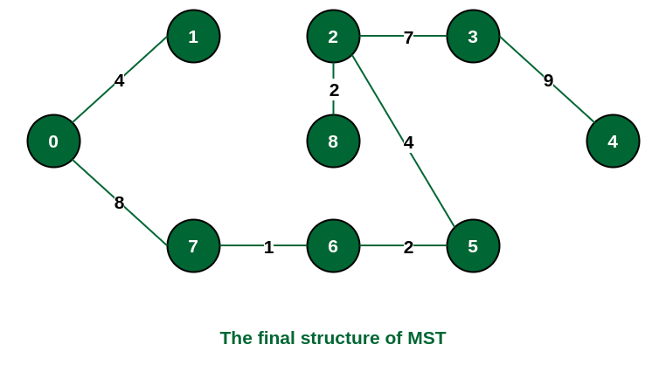
The final structure of the MST is as follows and the weight of the edges of the MST is (4 + 8 + 1 + 2 + 4 + 2 + 7 + 9) = 37.
Slide No.

Slide 67
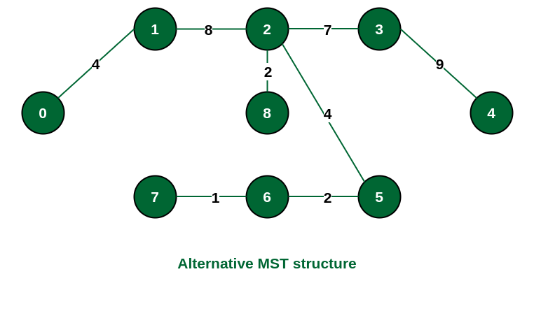
Note: If we had selected the edge {1, 2} in the third step then the MST would look like the following.
Slide No.

Slide 68
How to implement Prim’s Algorithm?
Follow the given steps to utilize the Prim’s Algorithm mentioned above for finding MST of a graph:
Create a set mstSet that keeps track of vertices already included in MST.
Assign a key value to all vertices in the input graph. Initialize all key values as INFINITE. Assign the key value as 0 for the first vertex so that it is picked first.
While mstSet doesn’t include all vertices
Pick a vertex u that is not there in mstSet and has a minimum key value.
Include u in the mstSet.
Update the key value of all adjacent vertices of u. To update the key values, iterate through all adjacent vertices.
For every adjacent vertex v, if the weight of edge u-v is less than the previous key value of v, update the key value as the weight of u-v.
Slide No.

Slide 69
The idea of using key values is to pick the minimum weight edge from the cut. The key values are used only for vertices that are not yet included in MST, the key value for these vertices indicates the minimum weight edges connecting them to the set of vertices included in MST.
Time Complexity:
O(V²), If the input graph is represented using an adjacency list, then the time complexity of Prim’s algorithm can be reduced to O(E * logV) with the help of a binary heap. In this implementation, we are always considering the spanning tree to start from the root of the graph
Slide No.

Slide 70
Other Implementations of Prim’s Algorithm:
Prim’s Algorithm for Adjacency Matrix Representation – In this article we have discussed the method of implementing Prim’s Algorithm if the graph is represented by an adjacency matrix.
Prim’s Algorithm for Adjacency List Representation – In this article Prim’s Algorithm implementation is described for graphs represented by an adjacency list.
Prim’s Algorithm using Priority Queue: In this article, we have discussed a time-efficient approach to implement Prim’s algorithm.
Slide No.

Slide 71
Dijkstra's Algorithm
Dijkstra's Algorithm is a Graph algorithm that finds the shortest path from a source vertex to all other vertices in the Graph (single source shortest path). It is a type of Greedy Algorithm that only works on Weighted Graphs having positive weights.
The time complexity of Dijkstra's Algorithm is O(V²) with the help of the adjacency matrix representation of the graph.
This time complexity can be reduced to O((V + E) log V) with the help of an adjacency list representation of the graph, where V is the number of vertices and E is the number of edges in the graph.
Slide No.

Slide 72
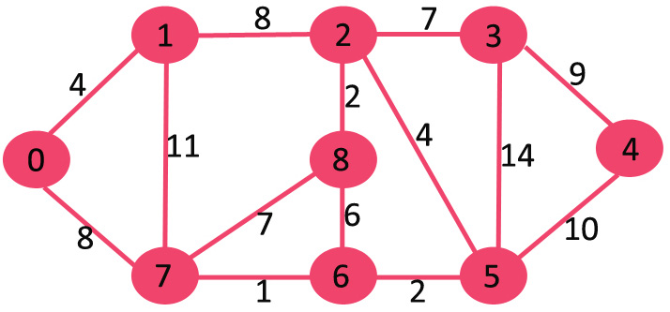
Given a graph and a source vertex in the graph, find the shortest paths from the source to all vertices in the given graph.
Examples:
Input: src = 0, the graph is shown below.
Output: 0 4 12 19 21 11 9 8 14 Explanation: The distance from 0 to 1 = 4. The minimum distance from 0 to 2 = 12. 0->1->2 The minimum distance from 0 to 3 = 19. 0->1->2->3 The minimum distance from 0 to 4 = 21. 0->7->6->5->4 The minimum distance from 0 to 5 = 11. 0->7->6->5 The minimum distance from 0 to 6 = 9. 0->7->6 The minimum distance from 0 to 7 = 8. 0->7 The minimum distance from 0 to 8 = 14. 0->1->2->8
Slide No.

Slide 73
Dijkstra shortest path algorithm for Adjacency Matrix in O(V²):
The idea is to generate a SPT (shortest path tree) with a given source as a root. Maintain an Adjacency Matrix with two sets,
one set contains vertices included in the shortest-path tree,
other set includes vertices not yet included in the shortest-path tree.
At every step of the algorithm, find a vertex that is in the other set (set not yet included) and has a minimum distance from the source.
Slide No.

Slide 74
Follow the steps below to solve the problem:
Create a set sptSet (shortest path tree set) that keeps track of vertices included in the shortest path tree, i.e., whose minimum distance from the source is calculated and finalized. Initially, this set is empty.
Assign a distance value to all vertices in the input graph. Initialize all distance values as INFINITE. Assign the distance value as 0 for the source vertex so that it is picked first.
While sptSet doesn’t include all vertices
Pick a vertex u that is not there in sptSet and has a minimum distance value.
Include u to sptSet.
Then update the distance value of all adjacent vertices of u.
To update the distance values, iterate through all adjacent vertices.
For every adjacent vertex v, if the sum of the distance value of u (from source) and weight of edge u-v, is less than the distance value of v, then update the distance value of v.
Slide No.

Slide 75
Pseudocode:
function Dijkstra_Algorithm(Graph, source_node)
// iterating through the nodes in Graph and set their distances to INFINITY
for each node N in Graph:
distance[N] = INFINITY
previous[N] = NULL
If N != source_node, add N to Priority Queue G
// setting the distance of the source node of the Graph to 0
distance[source_node] = 0
// iterating until the Priority Queue G is not empty
while G is NOT empty:
Slide No.

Slide 76
// selecting a node Q having the least distance and marking it as visited
Q = node in G with the least distance[]
mark Q visited
// iterating through the unvisited neighboring nodes of the node Q and performing relaxation accordingly
for each unvisited neighbor node N of Q:
temporary_distance = distance[Q] + distance_between(Q, N)
// if the temporary distance is less than the given distance of the path to the Node, updating the resultant distance with the minimum value
if temporary_distance < distance[N]
distance[N] := temporary_distance
Slide No.

Slide 77
previous[N] := Q
// returning the final list of distance
return distance[], previous[]
Slide No.

Slide 78
Illustration:
We use a boolean array sptSet[] to represent the set of vertices included in SPT. If a value sptSet[v] is true, then vertex v is included in SPT, otherwise not. Array dist[] is used to store the shortest distance values of all vertices.
To understand the Dijkstra’s Algorithm lets take a graph and find the shortest path from source to all nodes.
Consider below graph and src = 0
Slide No.

Slide 79

Step 1:
The set sptSet is initially empty and distances assigned to vertices are {0, INF, INF, INF, INF, INF, INF, INF} where INF indicates infinite.
Now pick the vertex with a minimum distance value. The vertex 0 is picked, include it in sptSet. So sptSet becomes {0}. After including 0 to sptSet, update distance values of its adjacent vertices.
Adjacent vertices of 0 are 1 and 7. The distance values of 1 and 7 are updated as 4 and 8.
The following subgraph shows vertices and their distance values, only the vertices with finite distance values are shown. The vertices included in SPT are shown in green colour.
Slide No.

Slide 80
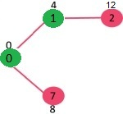
Step 2:
Pick the vertex with minimum distance value and not already included in SPT (not in sptSET). The vertex 1 is picked and added to sptSet.
So sptSet now becomes {0, 1}. Update the distance values of adjacent vertices of 1.
The distance value of vertex 2 becomes 12.
Slide No.

Slide 81
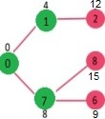
Step 3:
Pick the vertex with minimum distance value and not already included in SPT (not in sptSET). Vertex 7 is picked. So sptSet now becomes {0, 1, 7}.
Update the distance values of adjacent vertices of 7. The distance value of vertex 6 and 8 becomes finite (15 and 9 respectively).
Slide No.

Slide 82
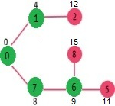
Step 4:
Pick the vertex with minimum distance value and not already included in SPT (not in sptSET). Vertex 6 is picked. So sptSet now becomes {0, 1, 7, 6}.
Update the distance values of adjacent vertices of 6. The distance value of vertex 5 and 8 are updated.
Slide No.

Slide 83
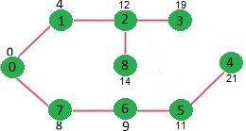
We repeat the above steps until sptSet includes all vertices of the given graph. Finally, we get the following Shortest Path Tree (SPT)
Slide No.

Slide 84
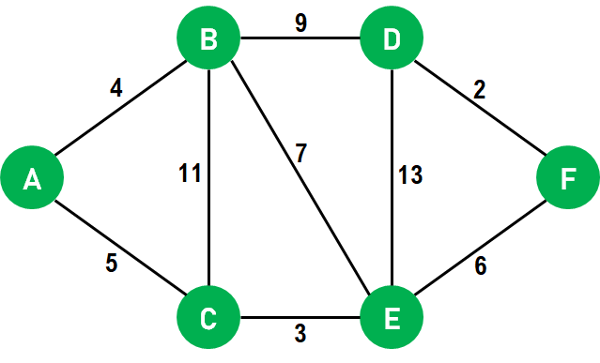
Example 2:-
Slide No.

Slide 85
Output:-
Distance from the Source Node to 1: 4
Distance from the Source Node to 2: 12
Distance from the Source Node to 3: 19
Distance from the Source Node to 4: 12
Distance from the Source Node to 5: 8
Distance from the Source Node to 6: 10
Slide No.

Slide 86
Advantages of Dijkstra's Algorithm
One primary advantage of using Dijkstra's Algorithm is that it has an almost linear time and space complexity.
We can use this algorithm to calculate the shortest path from a single vertex to all other vertices and a single source vertex to a single destination vertex by stopping the algorithm once we get the shortest distance for the destination vertex.
This algorithm only works for directed weighted graphs, and all the edges of this graph should be non-negative.
Slide No.

Slide 87
Disadvantages of Dijkstra's Algorithm
Dijkstra's Algorithm performs a concealed exploration that utilizes a lot of time during the process.
This algorithm is impotent to handle negative edges.
Since this algorithm heads to the acyclic graph, it cannot calculate the exact shortest path.
It also requires maintenance to keep a record of vertices that have been visited.
Slide No.

Slide 88
Applications of Dijkstra's Algorithm
Digital Mapping Services in Google Maps
Social Networking Applications
Telephone Network
Flight Program
IP routing to find Open Shortest Path First
Robotic Path
Designate the File Server
Slide No.

Slide 89
Dijkstra’s shortest path algorithm for Adjacency List using Heap in O(E logV):
For Dijkstra’s algorithm, it is always recommended to use heap (or priority queue) as the required operations (extract minimum and decrease key) match with the specialty of the heap (or priority queue).
However, the problem is, that priority_queue doesn’t support the decrease key. To resolve this problem, do not update a key, but insert one more copy of it. So we allow multiple instances of the same vertex in the priority queue. This approach doesn’t require decreasing key operations and has below important properties.
Whenever the distance of a vertex is reduced, we add one more instance of a vertex in priority queue. Even if there are multiple instances, we only consider the instance with minimum distance and ignore other instances.
The time complexity remains O(E * LogV) as there will be at most O(E) vertices in the priority queue and O(logE) is the same as O(logV)
Slide No.

Slide 90
Complexity
Time Complexity: O(E * logV), Where E is the number of edges and V is the number of vertices.
Auxiliary Space: O(V)
Slide No.

Slide 91
Bellman ford algorithm
Bellman ford algorithm is a single-source shortest path algorithm. This algorithm is used to find the shortest distance from the single vertex to all the other vertices of a weighted graph.
There are various other algorithms used to find the shortest path like Dijkstra algorithm, etc.
If the weighted graph contains the negative weight values, then the Dijkstra algorithm does not confirm whether it produces the correct answer or not.
In contrast to Dijkstra algorithm, bellman ford algorithm guarantees the correct answer even if the weighted graph contains the negative weight values.
Slide No.

Slide 92
Steps for finding the shortest distance to all vertices from the source using the Bellman-Ford algorithm:
This step initializes distances from the source to all vertices as infinite and distance to the source itself as 0. Create an array dist[] of size |V| with all values as infinite except dist[src] where src is source vertex.
This step calculates shortest distances. Do following |V|-1 times where |V| is the number of vertices in given graph. Do following for each edge u-v
If dist[v] > dist[u] + weight of edge uv, then update dist[v] to
dist[v] = dist[u] + weight of edge uv
This step reports if there is a negative weight cycle in the graph. Again traverse every edge and do following for each edge u-v ……If dist[v] > dist[u] + weight of edge uv, then “Graph contains negative weight cycle”
Slide No.

Slide 93
Cont…
The idea of step 3 is, step 2 guarantees the shortest distances if the graph doesn’t contain a negative weight cycle. If we iterate through all edges one more time and get a shorter path for any vertex, then there is a negative weight cycle
Below is the illustration of the above algorithm:
Step 1: Let the given source vertex be 0. Initialize all distances as infinite, except the distance to the source itself. Total number of vertices in the graph is 5, so all edges must be processed 4 times.
Slide No.

Slide 94
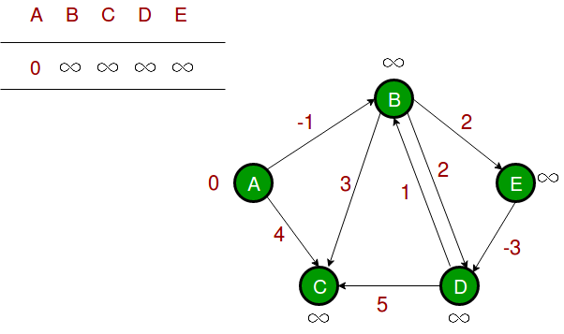
Step 1
Slide No.

Slide 95
Step 2: Let all edges are processed in the following order: (B, E), (D, B), (B, D), (A, B), (A, C), (D, C), (B, C), (E, D).
We get the following distances when all edges are processed the first time. The first row shows initial distances.
The second row shows distances when edges (B, E), (D, B), (B, D) and (A, B) are processed.
The third row shows distances when (A, C) is processed. The fourth row shows when (D, C), (B, C) and (E, D) are processed.
Slide No.

Slide 96
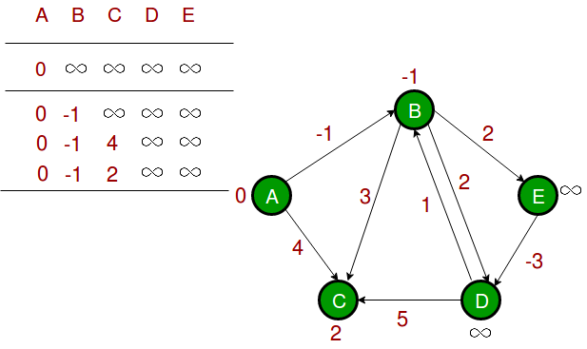
Step 2:
Slide No.

Slide 97
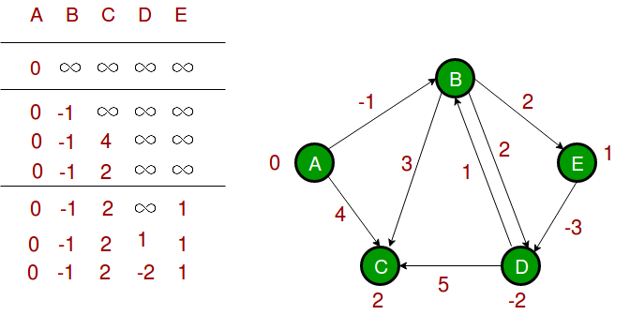
Step 3: The first iteration guarantees to give all shortest paths which are at most 1 edge long. We get the following distances when all edges are processed second time (The last row shows final values).
Slide No.

Slide 98
Step 4: The second iteration guarantees to give all shortest paths which are at most 2 edges long.
The algorithm processes all edges 2 more times.
The distances are minimized after the second iteration, so third and fourth iterations don’t update the distances.
Slide No.

Slide 99
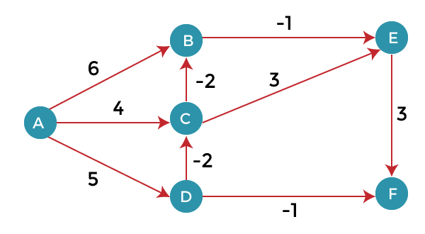
Examples 2
The following are the distances of vertices:
A: 0
B: 1
C: 3
D: 5
E: 0
F: 3
Slide No.

Slide 100
Complexity Analysis
Time Complexity: O(V * E), where V is the number of vertices in the graph and E is the number of edges in the graph
Auxiliary Space: O(E)
Slide No.

Slide 101
Important Points
Negative weights are found in various applications of graphs. For example, instead of paying the cost for a path, we may get some advantage if we follow the path.
Bellman-Ford works better (better than Dijkstra’s) for distributed systems. Unlike Dijkstra’s where we need to find the minimum value of all vertices, in Bellman-Ford, edges are considered one by one.
Bellman-Ford does not work with an undirected graph with negative edges as it will be declared as a negative cycle.
Slide No.

Slide 102
Algorithm
function bellmanFord(G, S)
for each vertex V in G
distance[V] <- infinite
previous[V] <- NULL
distance[S] <- 0
for each vertex V in G
for each edge (U,V) in G
tempDistance <- distance[U] + edge_weight(U, V)
if tempDistance < distance[V]
distance[V] <- tempDistance
previous[V] <- U
for each edge (U,V) in G
If distance[U] + edge_weight(U, V) < distance[V}
Error: Negative Cycle Exists
return distance[], previous[]
Slide No.

Slide 103
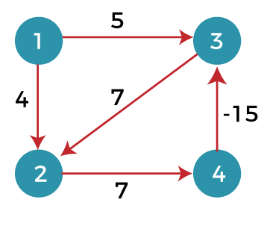
Drawbacks of Bellman ford algorithm
The bellman ford algorithm does not produce a correct answer if the sum of the edges of a cycle is negative. Let's understand this property through an example. Consider the below graph.
Slide No.

Slide 104
Slide No.

Slide 105
Slide No.

Slide 106
Slide No.

Slide 107
Slide No.

Slide 108
Slide No.

Slide 109
Slide No.

Slide 110

<Session Name>: Source
https://www.geeksforgeeks.org/
Slide No.

Slide 111

Time for a Break !
Slide No.

Slide 112

Any Doubts/Questions
Slide No.

Slide 113

Thank You

Slide 114








Icons To Be Used (Suggestions Only)
Hands on Exercise
Doubts/ Questions
Tools
Coding Standards
Test Your Understanding
Reference
A Welcome Break
Contacts
Demonstration
Slide No.

